Slide 1
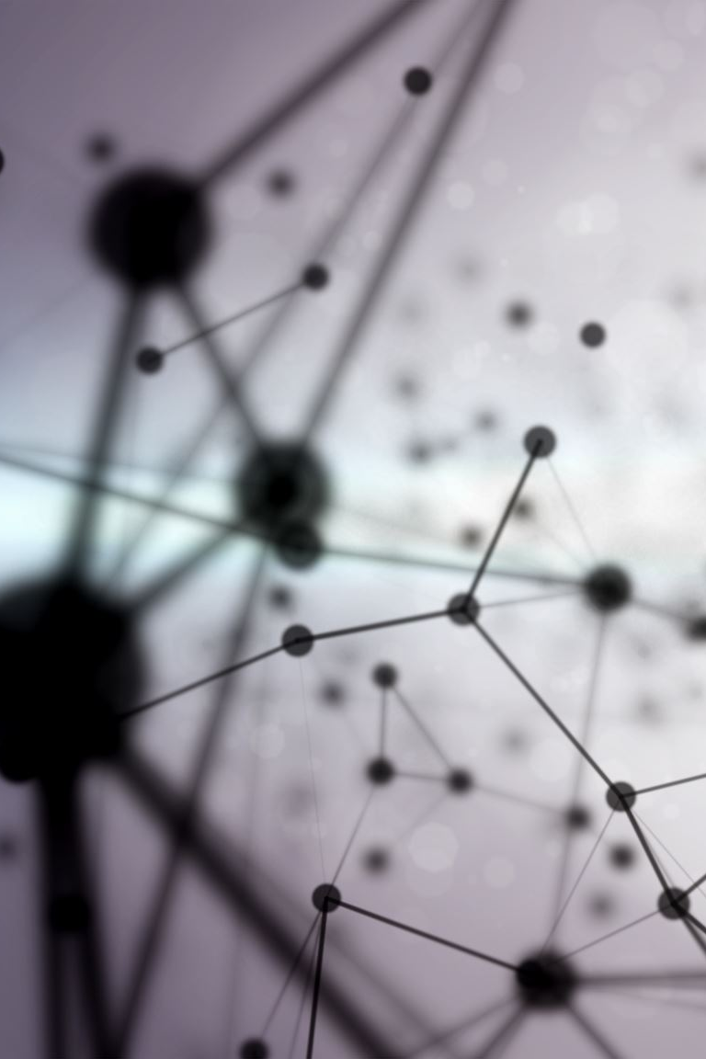
Intro to Machine Learning
by Dr. Ilias Georgakopoulos-Soares and Ioannis Mouratidis
Slides credit: Dr. C. Lee Giles, Dr. Christoph F. Eick
Notes:
I will cover a lot of the basics, but hopefully I can manage to everyone at least one thing that will be new for you.

Slide 2
What is Machine Learning?
Aspect of AI: creates knowledge
Definition:
“changes in [a] system that ... enable [it] to do the same task or tasks drawn from the same population more efficiently and more effectively the next time.'' (Simon 1983)
There are two ways that a system can improve:
1. By acquiring new knowledge
acquiring new facts
acquiring new skills
2. By adapting its behavior
solving problems more accurately
solving problems more efficiently

Slide 3
What is Learning?
Herbert Simon: “Learning is any process by which a system improves performance from experience.”
What is the task?
Classification
Categorization/clustering
Problem solving / planning / control
Prediction
others

Slide 4
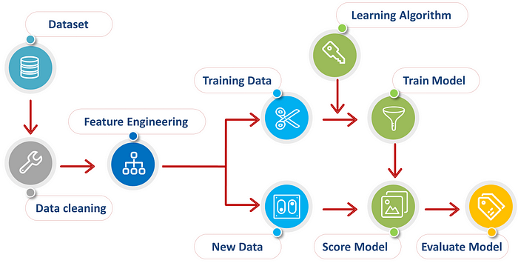
Credit: Afroz Chakure

Slide 5
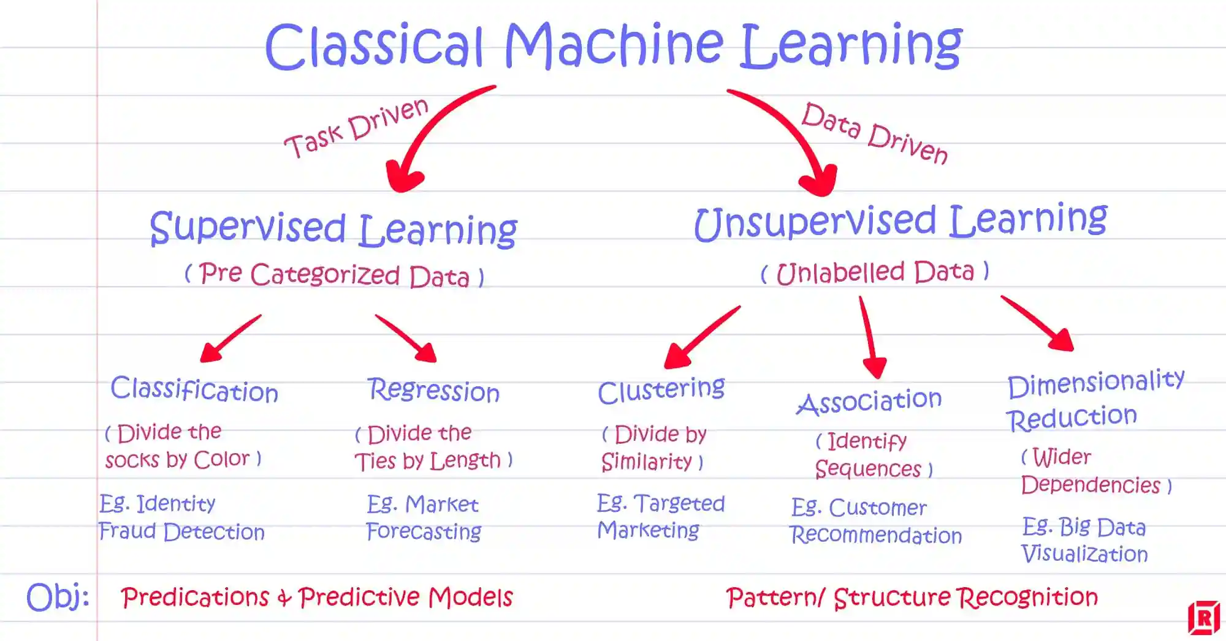
Credit: Labellerr.com

Slide 6
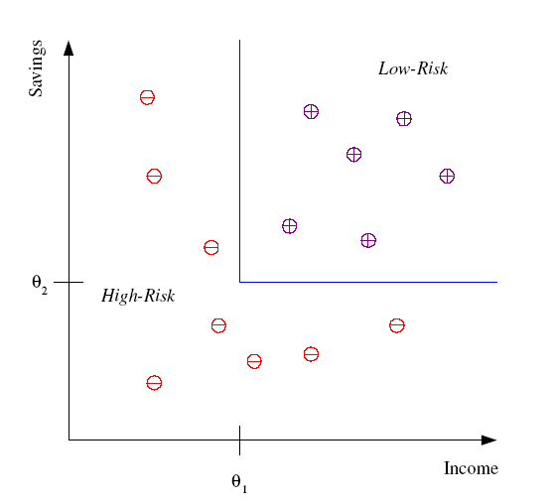
Classification
Example: Credit scoring
Differentiating between low-risk and high-risk customers from their income and savings
Discriminant: IF income > θ₁ AND savings > θ₂
THEN low-risk ELSE high-risk

Slide 7
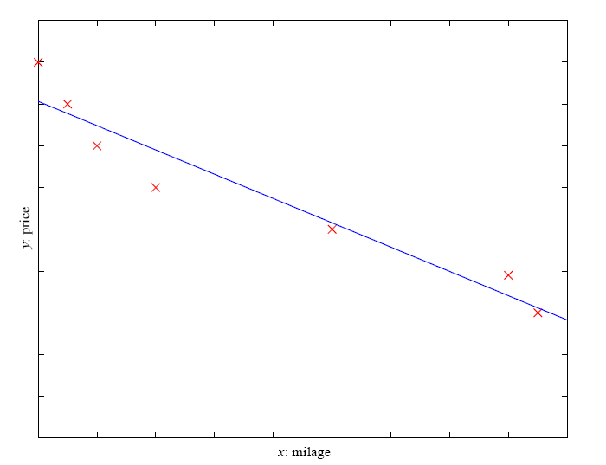
Prediction: Regression
Example: Price of a used car
x : car attributes
y : price
y = g (x | θ )
g ( ) model,
θ parameters
y = wx+w₀

Slide 8
Supervised Learning: Uses
Example: decision trees tools that create rules
Prediction of future cases: Use the rule to predict the output for future inputs
Knowledge extraction: The rule is easy to understand
Compression: The rule is simpler than the data it explains
Outlier detection: Exceptions that are not covered by the rule, e.g., fraud

Slide 9
Types of testing
Evaluate performance by testing on data NOT used for testing (both should be randomly sampled)
Cross validation methods for small data sets
The more (relevant) data the better.

Slide 10
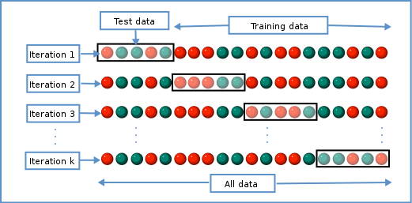
Cross-validation
Wikimedia commons

Slide 11
Testing
How well does the learned system work?
Generalization
Performance on unseen or unknown scenarios or data

Slide 12
Usual ML stages
Hypothesis, data
Training or learning
Testing or generalization

Slide 13
Working Applications of ML
Character recognition
Face recognition
Disease detection from mNGS data
Gene expression prediction
Cancer detection through liquid biopsies

Slide 14
More reading
Hernández Medina et al, Machine learning and deep learning applications in microbiome research, ISME COMMUN. https://doi.org/10.1038/s43705-022-00182-9
Marcos-Zambrano et al, Applications of Machine Learning in Human Microbiome Studies: A Review on Feature Selection, Biomarker Identification, Disease Prediction and Treatment, Frontiers in Microbiology, https://doi.org/10.3389/fmicb.2021.634511

Slide 15
Measuring Performance
Generalization accuracy
Solution correctness
Solution quality (length, efficiency)
Speed of performance

Slide 16
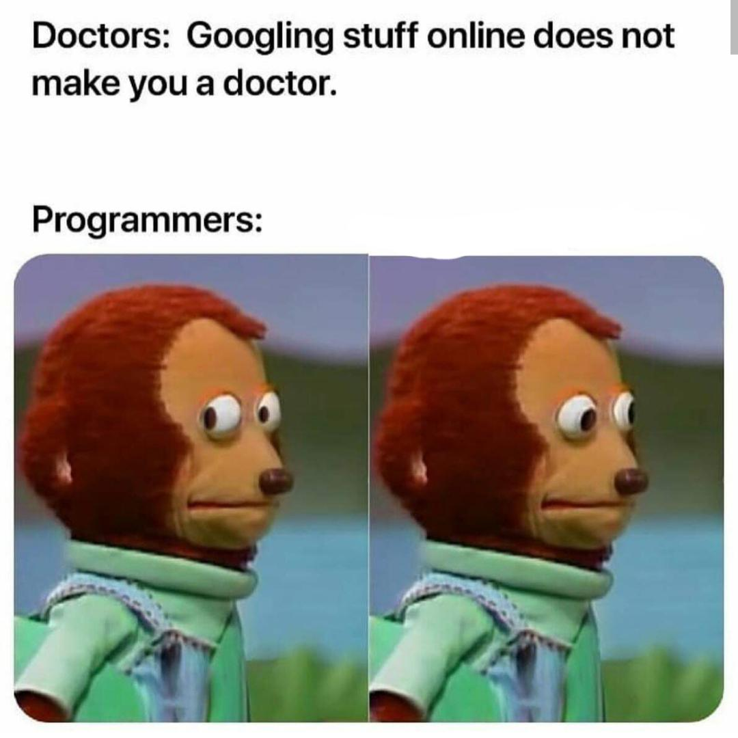
Google is your friend
ChatGPT maybe too
Notes:
I added because it’s the one I personally find more difficult – but it applies to everything
If you’re struggling with something ask in the Slack

Slide 17
Roar Collab tips
Roar vs Roar Collab (use Roar Collab/SLURM/sbatch – ignore qsub/PBS)
Open OnDemand to use Jupyter/VS Code on interactive cluster nodes
Roar Collab Usage guide: https://www.icds.psu.edu/roar-collab-user-guide/
i-ASK Helpdesk (incl. Virtual office hours): https://www.icds.psu.edu/computing-services/support/
Notes:
Roar is the older cluster and is outdated.
Use an SSH client especially on windows
Be careful to use the Roar Collab version of Open OnDemand
Try to think about ways to parallelize your workflow and make it more efficient. That is a whole other topic that I am personally passionate about, but for another time.
“Slack Helpdesk” are your colleagues

Slide 18
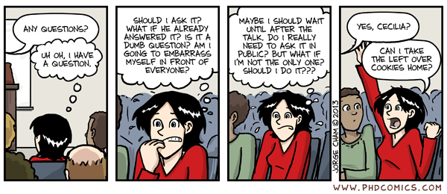
Questions?

Slide 19
Further resources
Real Python: https://realpython.com/
mCoding: https://www.youtube.com/@mCoding
Pandas tutorial: https://www.youtube.com/watch?v=vmEHCJofslg
60 linux commands in 10 minutes: https://youtu.be/gd7BXuUQ91w
Machine Learning Mastery: https://machinelearningmastery.com/start-here/
Notes:
Highly recommend the mCoding channel – have been programming in Python for 10 years and even in videos where I know the topic found there is always at least one new thing for me to learn. That’s for example where I learned about f-strings with equals sign.

